Slide 1

Presentation On phishing and brute force
Trainer :- Tapan Sir
Presented by:-
Kundan Gawande(28806)

Slide 2

Phishing
Deception:
Phishing attacks rely on deception. Attackers craft convincing communications (emails, text messages, etc.) that mimic legitimate sources, making them appear genuine.
Social Engineering:
These attacks exploit human psychology and trust. Attackers use various tactics to create a sense of urgency or authority, luring users into taking action.
Goal:
The primary goal of phishing is to steal sensitive information or install malware on the victim's device

Slide 3

Types of Phishing
Email Phishing
Spear Phishing
Whaling
Smishing (SMS Phishing)
Vishing (Voice Phishing)
Clone Phishing
Pharming
Angler Phishing
HTTPS phishing

Slide 4
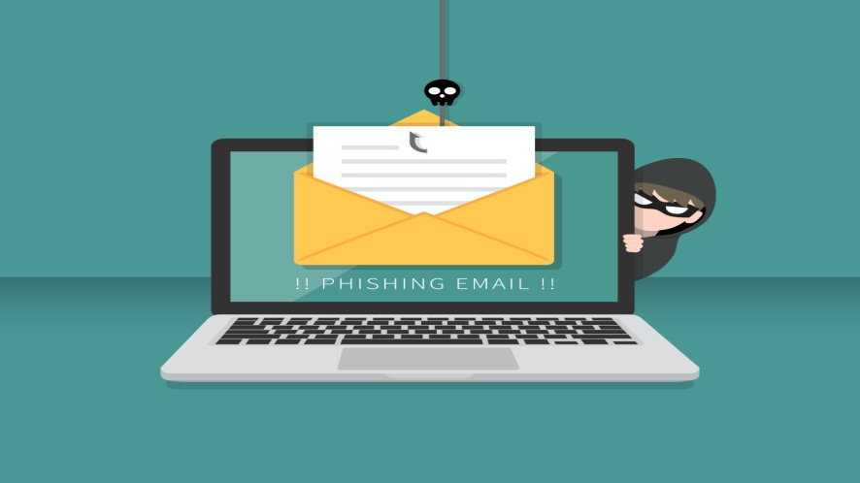
Email Phishing
Description: The most common type. Attackers send fraudulent emails that appear to come from reputable sources (e.g., banks, online services).
Goal: Trick recipients into clicking malicious links or downloading attachments.
Example: “Your account has been compromised. Click here to reset your password.”

Slide 5

Spear Phishing
Description: A targeted version of email phishing. Messages are customized for a specific individual or organization.
Goal: Increase the chances of success by making the message seem legitimate and personalized.
Example: An email from "your boss" asking you to urgently transfer funds or provide confidential documents.

Slide 6
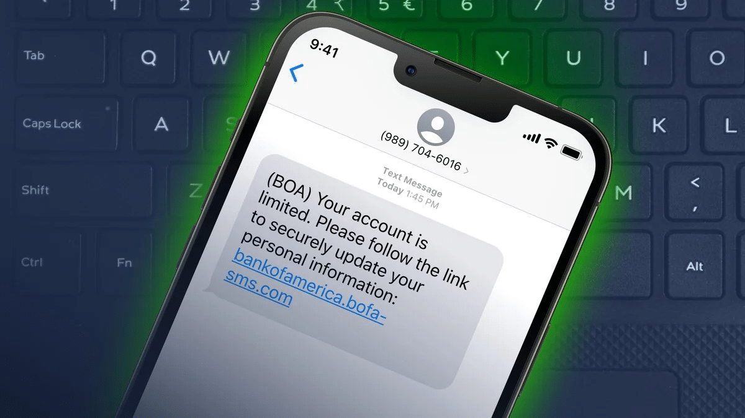
Smishing (SMS Phishing)
Description: Phishing through text messages.
Goal: Trick users into clicking a malicious link or calling a fake support number.
Example: “Your package is held at customs. Click this link to pay the fee.”

Slide 7

Vishing(Voice Phishing)
Description: Phishing over phone calls.
Goal: Get the victim to share confidential information over the phone.
Example: Call claiming to be from your bank or IRS requesting verification of identity.

Slide 8

HTTPS Phishing
Description: A phishing attack that uses a website with an HTTPS (secure) URL to appear legitimate.
Goal: Trick users into thinking the site is safe just because it has a padlock icon and uses HTTPS.
How It Works:
Attackers register a domain name that looks like a real one (e.g., faceb00k-security.com or paypa1.com).
They then get a valid SSL certificate, so the site shows the padlock icon and uses https://.
Users are lured via email, SMS, or social media to visit the fake site.
The fake site asks them to enter login credentials, credit card info, or other personal data.

Slide 9

Brute Force Attack
Definition: A brute force attack is a method used by attackers to guess passwords or encryption keys by trying all possible combinations until the correct one is found.
Goal: To gain unauthorized access to a system (like a login page, SSH server, admin panel, etc.) by systematically guessing the credentials.

Slide 10
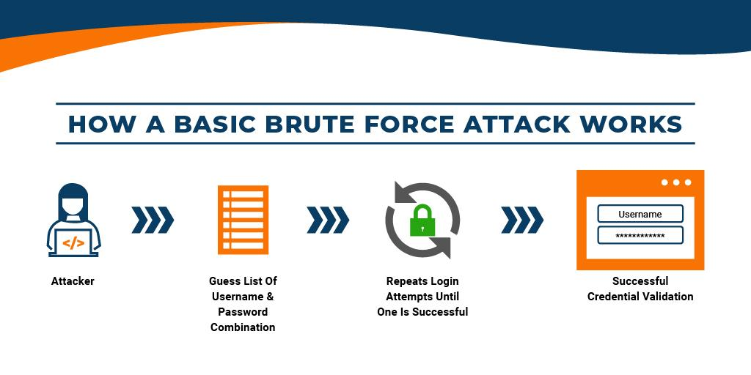

Slide 11
How it Works??
How Brute Force Attempts Work
Target is Identified
Example: A login form like DVWA (http://localhost/dvwa/login.php)
Username is Set (or Guessed)
Common usernames: admin, root, user
Passwords Are Guessed Repeatedly
Using a list (called a dictionary) or all combinations (pure brute force), the attacker tries many passwords like:
password password123 admin qwerty 123456
Tools Used for Automation
Tools like Hydra, Burp Suite, Medusa, or custom Python scripts send hundreds or thousands of login requests rapidly.
Successful Login
Once the correct combination is found, the attacker gains access.

Slide 12
Type | Description
Simple Brute Force | Tries all combinations (e.g., a, aa, aaa, etc.). Very slow.
Dictionary Attack | Uses a pre-defined list of common passwords. Faster and more efficient.
Credential Stuffing | Uses known leaked username-password pairs from data breaches.
Reverse Brute Force | Tries one common password (e.g., 123456) across many usernames.

Slide 13
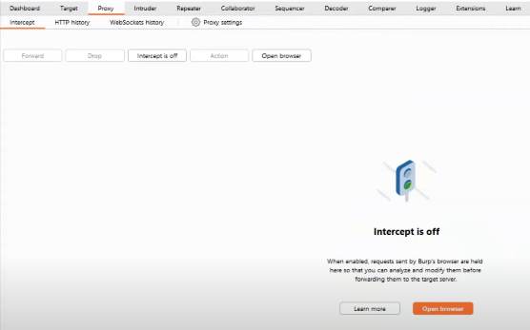
Step no1:- Open Burp suite in your system and navigate to proxy section

Slide 14
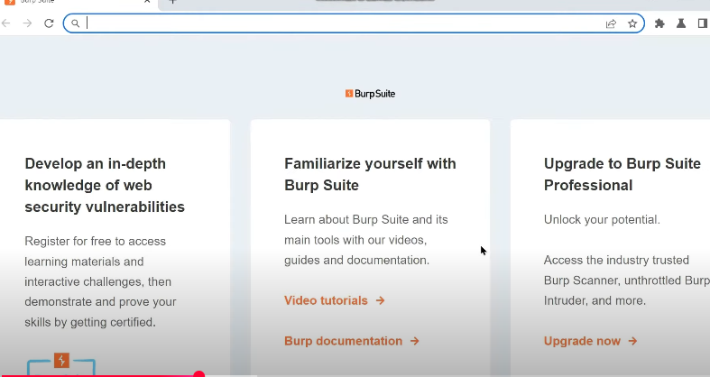
Stepno2:- Click on open browser, the below browser will open .

Slide 15
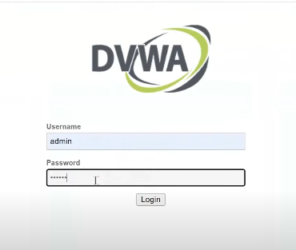
Step No.3:- Enter ‘localhost/DVWA-master/login.php’ and this login page will display , Enter login credentials and login into it.

Slide 16
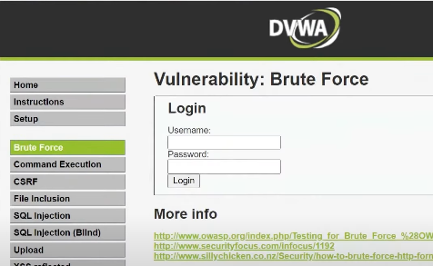
Step No.4:- After login, Select Brute Force, Before login ,turn on intercept from burpsuite

Slide 17

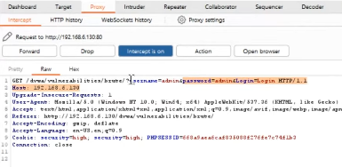
Step No.5:- Turn On the Intercept from Burp Suite
Step No.6:-After Login this Page will Appear

Slide 18
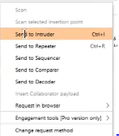
Step No.7:-Select Username and Pwd and click on ‘send to intruder’,Navigate to Intruder

Slide 19
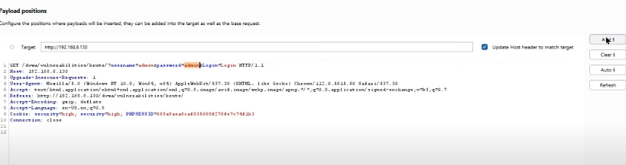
Step No.8:- Under payload ,click on clear , and clear all
Step No.9:- Select password value and click on add under payload

Slide 20
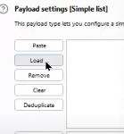
Step No.10:-Now select the attack type as ‘SNIPER ATTACK’
Step No.11:- Now load the common known password files under payload settings

Slide 21
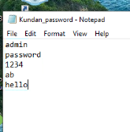
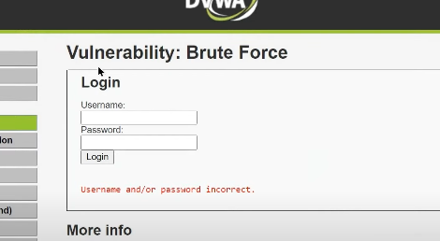
Step No.12:- This the file need to be load ‘kundan_password’
Step No.13:- Now try to login using wrong password

Slide 22
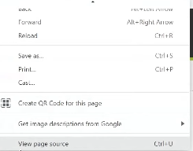
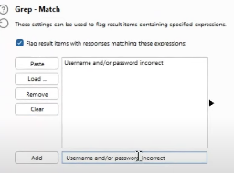
Step No.14:- Now click on view page source and copy the error message
Step No.15:- Now under settings paste the message here and add it and flag it

Slide 23
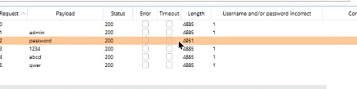
Step No.16:- Initiate the attack
Step No.17:-Finally it shows for which password it did not got the error mesage

Slide 24


